Slide 1
IOT ARCHITECTURE

Slide 2
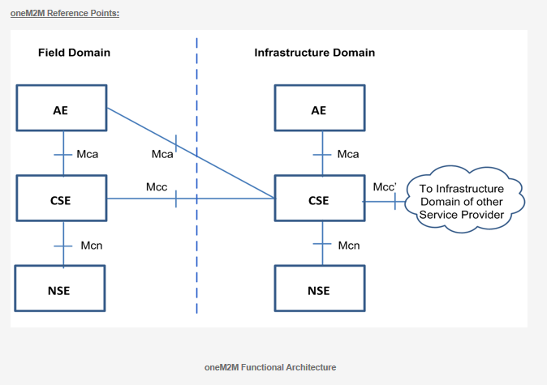
oneM2M IoT STD Architecture
It is a layered model
It has three layers
Application Layer
Common Entity Layer
Network Service Layer

Slide 3
Application Entity (AE)
It is the entity in application layer which will perform M2M application.
AE will have application service logic.
Application service logic will be part of many M2M nodes or single M2M nodes.
Each Application Entity will have AE – ID.
Various applications that can be included in AE -
Blood sugar monitoring application
Power metering application
Controlling application.

Slide 4
Common Service Entity
It represents “common service functions”.
Service functions are exposed to other entities through Mca & Mcc.
Functions of CSE -
Data Management
Device Management
Subscription Management
Location service

Slide 5
Network Service Entity (NSE)
It is entity which provides network layer.
It is the COMMUNICATION DOMAIN for the IOT devices & endpoints.
It links devices & network
Include wireless technologies IEEE.802.15.4(wire less N/W – require for IOT application) etc.

Slide 6
Network Service Entity (NSE)
Mca – Communication between AE & CSE. (M2M communication application interface)
Mcc- reference point communication between two CSE’s. This enables CSE to use service provided by other CSE
Mcn- communication between CSE & NSE. This helps CSE to get support services like transport & connectivity services
Mcc’ – Communications between CSE’s in infrastructure domain to another CSE which with service provides domain.

Slide 7
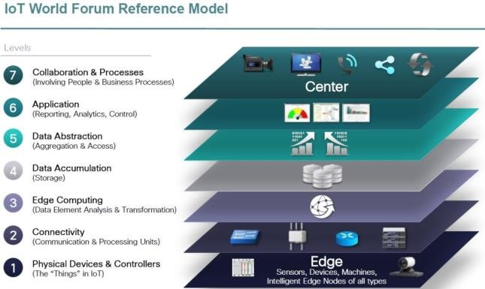
IoT World Forum Standardized Architecture

Slide 8
IOT World Form Std Architecture
IOTWF architectural committee publishes 7 layered IOT architectural reference Model in 2014.
This committee was led by CISCO, IBM, Rockwell automation.
It offers clean, simplified perspective on IOT.
Includes edge computing, data storage and access.

Slide 9
Physical Device & Controllers (layer 1)
This layer has “things” as in IOT.
“Things” are capable of send & receive information.
Primary function is generating data.
“Things” can be controlled remotely over Network.
List of things is extensive.
No rules about size, location form factor or Origin.
“Things” could be simple “Silicon chip” or as big as “CAR”
Hundreds of Manufacturer can produce IOT devices.

Slide 10
Connectivity (layer 2)
It focus on CONNECTIVITY.
Function of this layer reliably & timely TRANSMISSION OF DATA.
Date transmission could be between devices & N/W or across the N\W
Connectivity Includes------
Implementation using of various protocols
Routing
Switching
Security at the N/W layer
Delivery across Network

Slide 11
Edge (Fog) computing (layer3)
It is called as “fog” computing.
It emphasis on DATA REDUCTION.
It converts N/W data flow into information that is ready for storage and processing by higher layers.
Main basic principle of this layer is information processing as early as possible to avoid too much data being transported to higher layers.
Data processing should be done close to device as far as possible.
Another function of this layer is the evaluation of data
Data can be filtered or aggregated before sending it to higher layers.
Data is decoded and restricted making additional processing.
Last function of this layer to assess the collected data and generate alerts.

Slide 12
Data Accumulation (layer 4)
Data received is “in motion”.
Most application do not need data in real time.
Most application run on “data at rest”.
This layer converts “data in motion” to “ data in rest”
Data usability finds out data is really required by higher level or not.
Data Persistence it determines whether data must be stored. If yes, where it must be stored & in which format & how long.
Data Accumulation
It determines whether data must be recombined, recomputed or aggregated with previously stored information
It checks whether any data has come from any non-IOT sources.

Slide 13
Data Abstraction(Reduction)(layer 5)
IOT needs to scale to a corporate or even global level.
IOT needs multiple storage system to accommodate IOT device data.
Data Abstraction functions on rendering(gathering)data & its storage in way so that can be used for particular application.
It consolidates multiple data format.
It ensure data completeness for higher level application.
Visualize data and consolidate from various sources.
Secure & protect data.

Slide 14
Application (layer 6)
At this layer information interpretation occurs.
Software at this level well interact with layer 5 and data at rest.
Application is based on requirements, nature of device data and business needs.
Some application focus on monitoring device data.
Some application focus on controlling devices.
Some application combine device & Non device data.
In IOT Ref Model Application layer is not well defined.

Slide 15
Collaboration & Processes (layer 7)
It deals with collaboration and process.
Multiple people uses same application for different purposes.
Application layer gives business people right data at the right time so they can do right things.
Application layer also provides associated data for their needs.
This layer ensures people will be able to communicate, collaborate data and various processes as per their needs to run specific application.

Slide 16
Security in the IOT
Reference Model also highlights the need for security at each level.
Each device in a system should be secured.
Each process must be secured.
Communication between each layer must be secured.
Movement of data, control between layers must be secured.

